Slide 1
Visual Servoing of a Robotic Arm using fitted Q-Iteration
EEE-587 Optimal Control
TEAM 8
Rakshith Vishwanatha: 1217756241
Mohit Mukul Bhagwat: 1217374990
Ravi Pipaliya: 1217413275

Slide 2
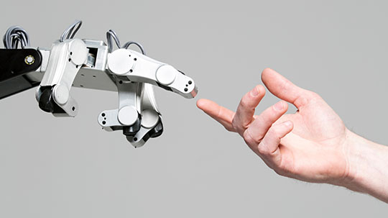
Table of contents
1. Introduction
2. Problem Formulation
3. Approach
4. Implementation
5. Results

Slide 3
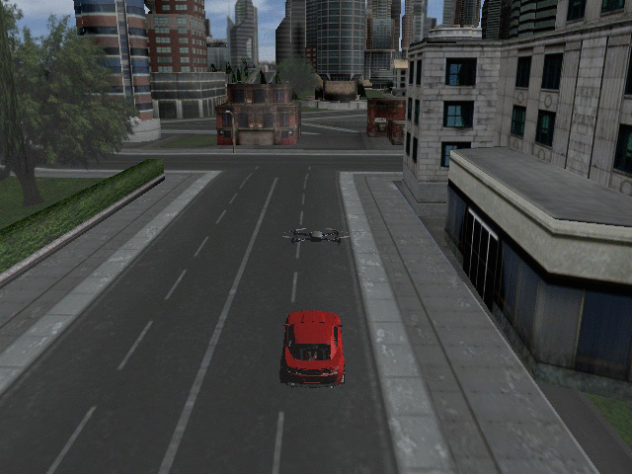
INTRODUCTION
Visual servoing involves choosing actions that move a robot in response to observations from a camera, in order to reach a goal configuration in the world
Visual servoing for 2-DOF robotic arm to track an object
Approximate RL approach (fitted Q-iteration) for continuous action space
Simulation setup in Gazebo, ROS and python

Slide 4
Problem Formulation

Slide 5
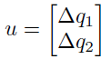
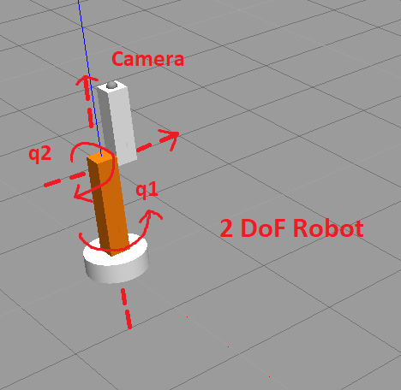
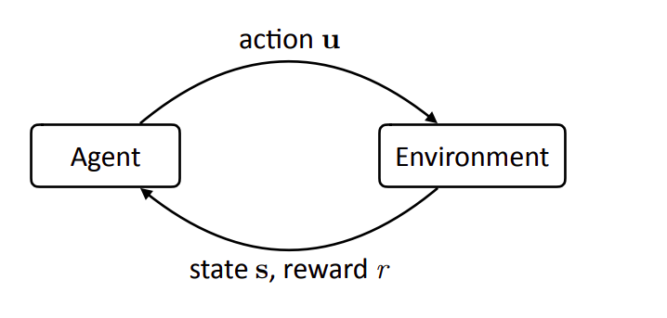
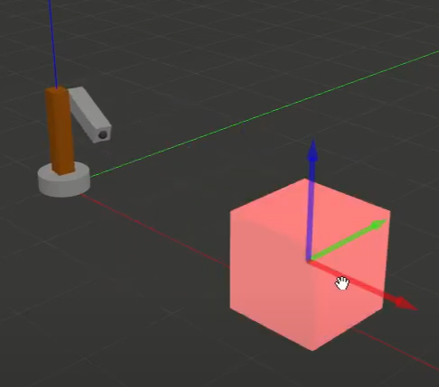
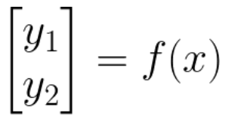
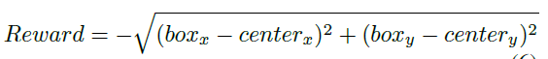
Problem Formulation
Change in joint angle
(Continuous)
Pixel coordinates of box location in camera frame
Negative of Euclidean distance from goal position

Slide 6
How did we approach the problem ?

Slide 7
APPROACH
Feature Detection
Bilinear Dynamics
Fitted Q-iteration
In this step we try to detect the position of the object (Box) using Opencv Libraries to differentiate the object based on the color.
We fitted a simple bilinear model to predict the next state of the box given the current state and the control input
Lastly we implement an approximate RL algorithm to learn the optimal policy

Slide 8
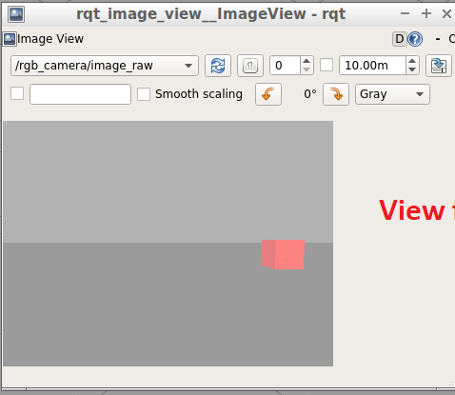
Feature detection
The red channel of the camera image is extracted and thresholded. This gives all the pixels that correspond to the box.
Now, taking the average x and y pixel locations of the pixels that passed the threshold gives the center location of the box.
Goal: Box location in the camera frame should be at pixel (320, 240)
Target Position
Camera

Slide 9
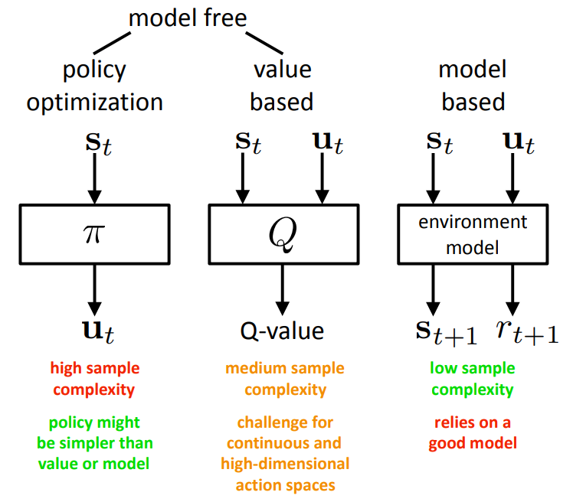
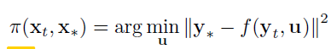
Why are we fitting a Model?

Slide 10
Bilinear dynamics
The dynamics of the arm is learnt through generating a Bi-Linear Model using the data collected through the wide range of possible motions of the arm
To fit the parameters we minimize the squared L-2 norm between the predicted and actual position after applying a control action
We find the optimal parameters using ADAM optimizer
Bilinear Model Form:

Slide 11
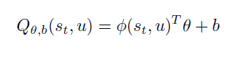
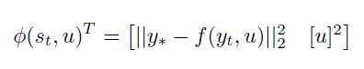
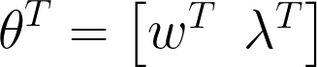
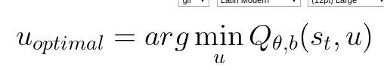
Q Function
Q-function
Linear approximator:
Parameter
Bias
Observations
Parameters
Minimum control effort
Target Position
Predicted next position

Slide 12
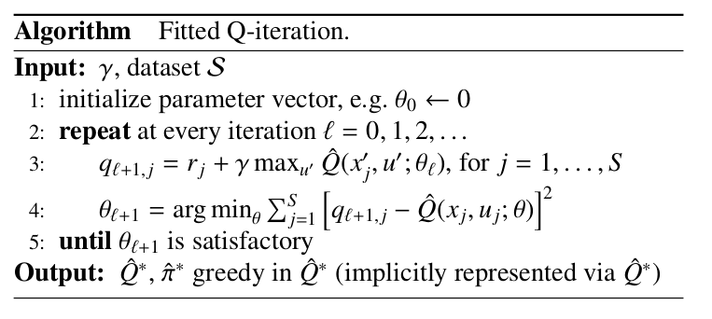
Fitted Q-iteration
Bellman Target
min
c
Bellman error

Slide 13
How did we implement ?

Slide 14
Implementation Details
Gazebo
ROS
Python
The simulation of the environment for the Two-joint robotic arm done using Gazebo
We used ROS as an interface to communicate with the Gazebo environment for data collection and sending control inputs
Model fitting and RL algorithm implementation was done using python

Slide 15
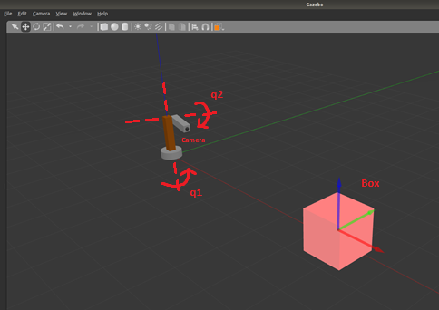
Gazebo environment

Slide 16
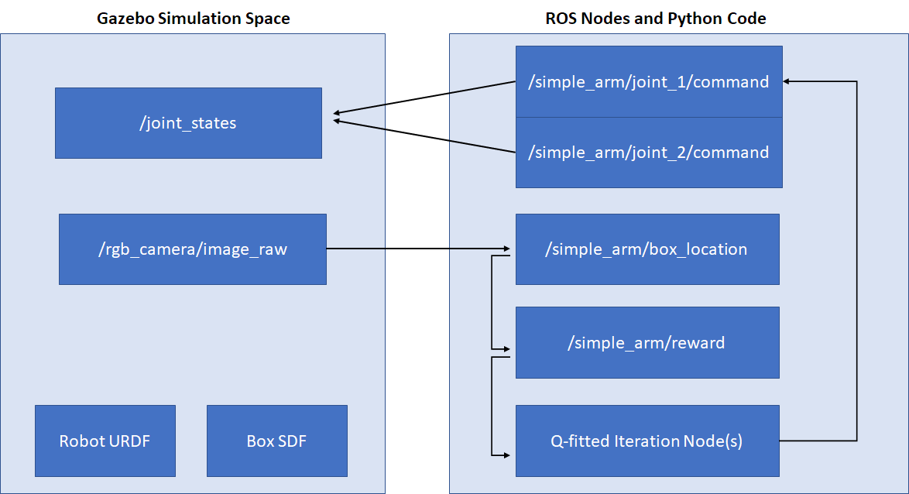
ROS setup

Slide 17
Specifications
Environment
Camera Image: 640 X 480 pixel (307,200 states)
Target Position: 320, 240
q1: +ve anticlockwise, q2: +ve clockwise
ARM Workspace: Hemisphere for q1 = [-pi/2, pi/2] and q2 = [-pi/2, pi/2]
Learning:
Bilinear model: Trained on 100,000 random samples (ADAM optimizer)
Fitted Q-iteration:
Gamma: 0.9 (Discount factor)
Q-Iterations: 10
Batch Size: 2000 samples
Exploration policy: Gaussian (mean: Current policy, SD: 0.2 radian)

Slide 18
What results did we get ?

Slide 19
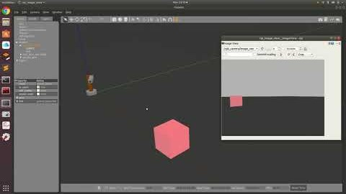
Data collection
We fit dynamics model as follows:
Takes random actions for each data sample until the box is out of frame
Resets to box in random location in the frame when box goes out of frame

Slide 20
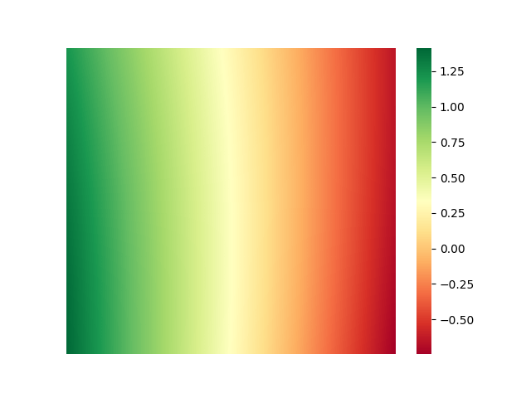
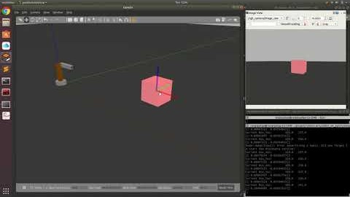
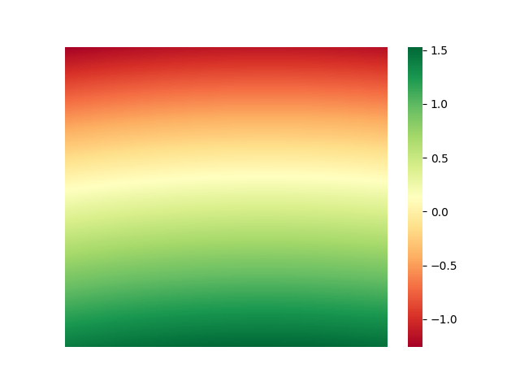
Results: Without FQI
State-Action Space
Action 1
(Move Left)
(Move Right)
Action 2
(Move Down)
(Move Up)
Actions: angle in radians

Slide 21
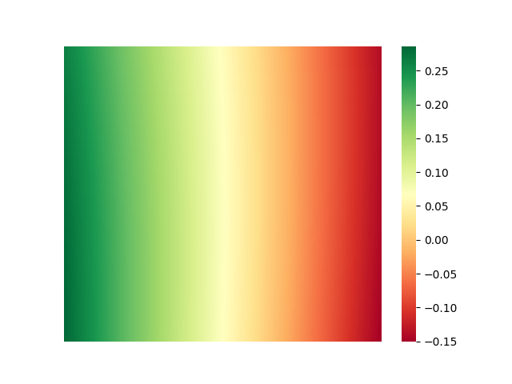
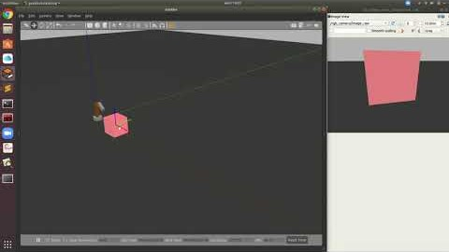
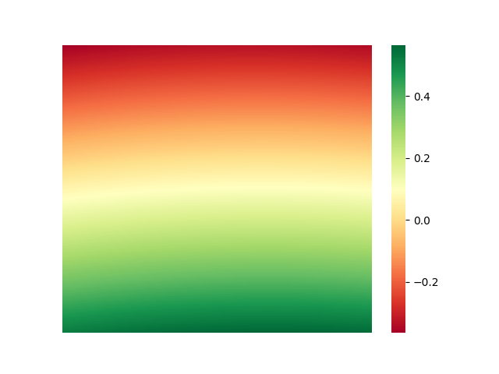
Results: With FQI
State-Action Space
Action 1
(Move Left)
(Move Right)
Action 2
(Move Down)
(Move Up)
Actions: angle in radians

Slide 22
In conclusion we were able to ...
Setup a simulated test environment in Gazebo for testing RL algorithms
Learn object tracking task on a 2-DOF robotic arm by combining value based and model based approach
Understand some of the nuances of working with continuous state-action space and approximate RL-approach

Slide 23

Questions

Slide 24
References
[1] Alex X. Lee, Sergey Levine, Pieter Abbeel (2017) ”Learning Visual
Servoing with Deep Features and Fitted Q-Iteration” In the International
Conference on Learning Representations (ICLR)
[2] Busoniu, Lucian de Bruin, Tim Toli´c, Domagoj Kober, Jens
Palunko, Ivana. (2018). Reinforcement learning for control: Performance,
stability, and deep approximators. Annual Reviews in Control
10.1016/j.arcontrol.2018.09.005.
[3] R. S. Sutton and A. G. Barto. 2018. Reinforcement Learning: An
Introduction. The MIT Press
[4] OpenCV, 2015. Open Source Computer Vision Library
[5] Robot Operating System [ROS] Kinetic, Gazebo

Slide 25
Visual Servoing of a Robotic Arm using fitted Q-Iteration
EEE-587 Optimal Control
TEAM 8
Thank You
Rakshith Vishwanatha: 1217756241
Mohit Bhagwat: 1217374990
Ravi Pipaliya: 1217413275

Slide 26
Appendix

Slide 27
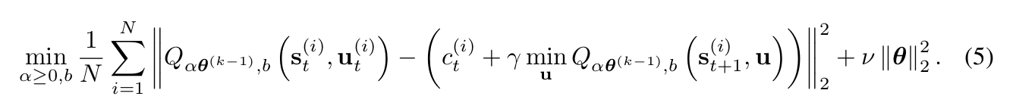
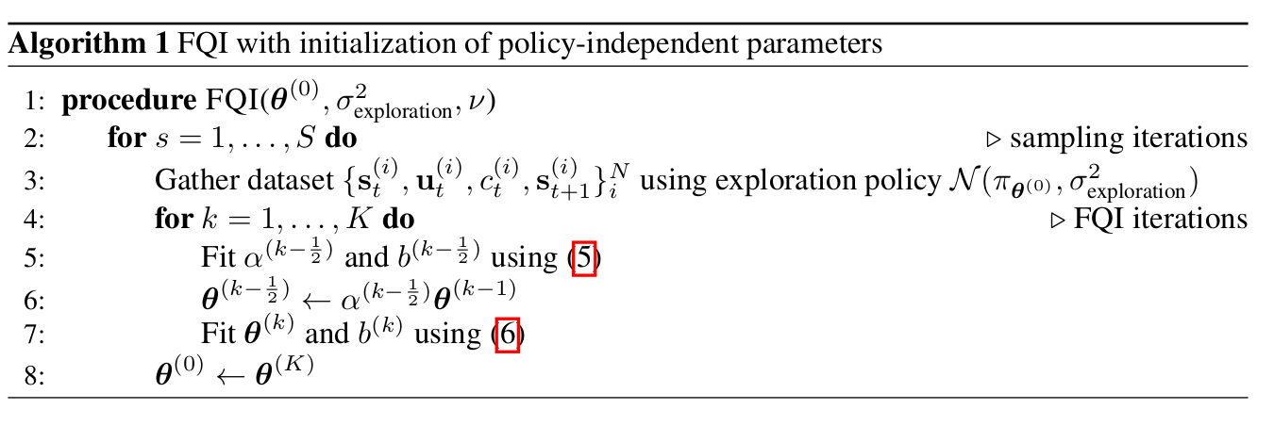
FQI with initialization of policy-independent parameters
Current Q
Target Q

Slide 28
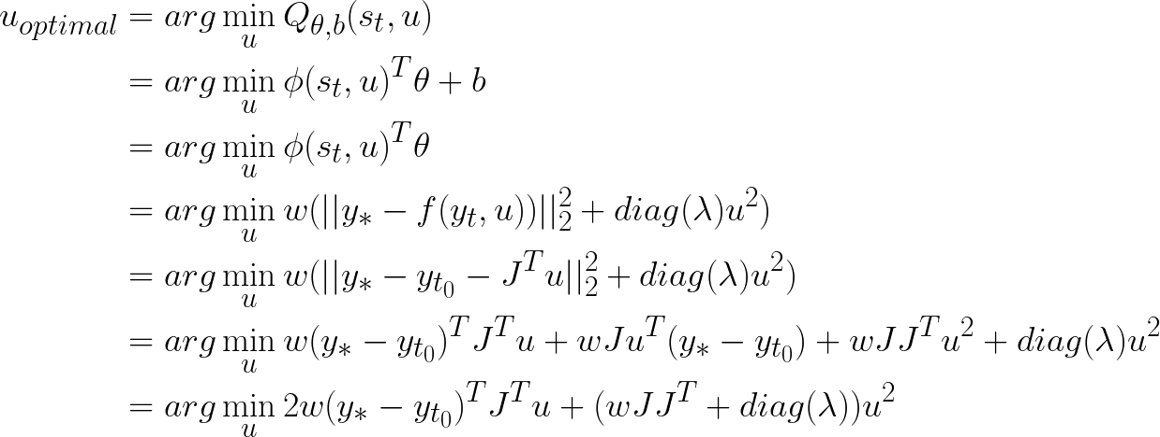
Extraing policy from Q function

